Slide 1

Coursera Capstone IBM Data Science Capstone Recommended Location for Starting Pharmacy in Brooklyn
BY Sebin THOMAS
14-JAN-2021

Slide 2
Business Problem
The pandemic has brought in un precedented needs for having pharmacies available to densely populated cities.
The area under focus is Brooklyn
Business Question
Since Brooklyn already has quite a number of pharmacies available. What is the ideal location for opening a new one for the stakeholders to make a thoughtful decision

Slide 3
Methodology
Web Scraping Wikipedia to get the neighborhood list.
Get Latitude And Longitude using Geo Coder.
Use Foursquare API to get the pharmacy data.
Group neighborhood data the density
Perform Clustering using k-means algorithm for finding the optimal location.

Slide 4
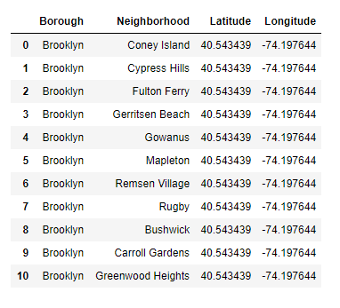
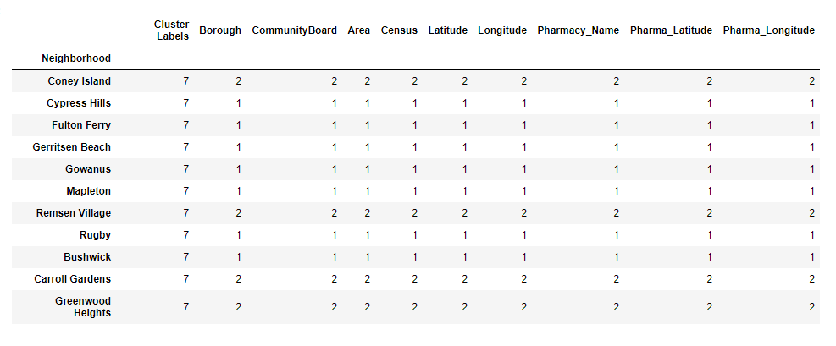
Results
After clustering Cluster 7 came out to be the one with least density

Slide 5
Discussion And Recommendation
After reviewing the pharmacies across the Brooklyn neighborhoods, the above locations came out as the least number of pharmacies. Which can be considered for further evaluation and decision making.

